Slide 1
SECJ2013 - DSA
Group members:
Lau Yee Wen A23CS0099
Gui Kah Sin A23CS0080
2024/2025-1
QUIZ 1

Slide 2
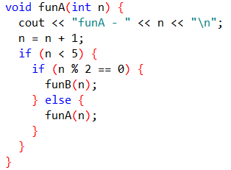
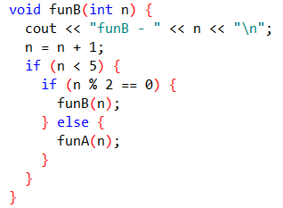
Given that two functions (funA and funB) have been defined as follows:
Study the funA and funB functions above. Identify the followings:
Instruction to check if the terminal case has been reached: __if(n<5)___________
Instruction to change the size of the problem so the terminal case can be reached: ____n=n+1________

Slide 3

Trace the recursive calls of the funA and funB functions inside the following main function of a C++ program:
Output: funA – 1
Output:
funA – 1
funB – 2
funA(1)
Output:
funA – 1
funB – 2
funA – 3
n= 1+1, n=2
if(2<5)
if(2%2==0)
1
Output:
funA – 1
funB – 2
funA – 3
funB – 4
funB(2)
n= 2+1, n=3
if(3<5)
3%5!=0
2
funA(3)
n= 3+1, n=4
if(4<5)
if(4%2==0)
3
funB(4)
n= 4+1, n=5
if(5<5) //reach the terminal case

